Slide 1
287. Find the Duplicate Number

Slide 2
qsort_way(wrong way)
nums = [3,1,3,4,2]
qsort
nums = [1,2,3,3,4]
If(num[i]==num[i+1])Return true;

Slide 3
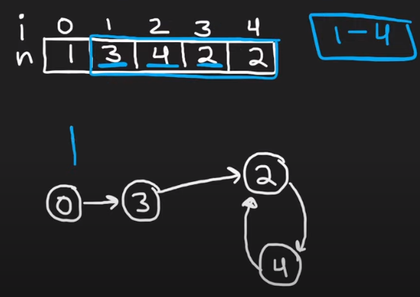
fast
slow

Slide 4
fast
slow

Slide 5
fast
slow

Slide 6
fast
slow

Slide 7
fast
slow

Slide 8
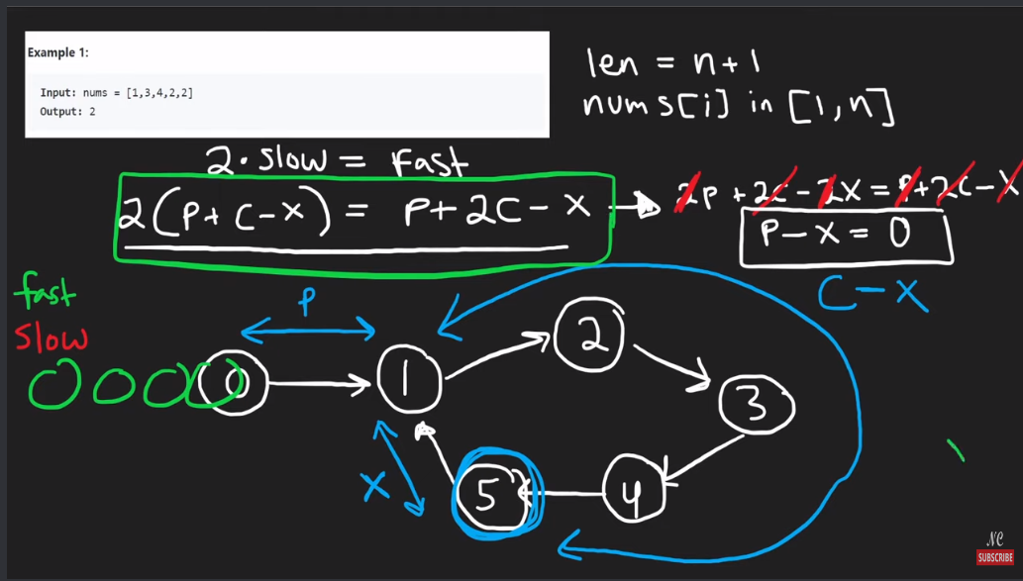
Slow 從 p開始
Fast 從 c-x開始
因為p長度=x
先找到c-x的節點

Slide 9
Fast
slow

Slide 10
Fast
slow

Slide 11
Fast
slow

Slide 12
Fast
slow

Slide 13
RESET SLOW
slow
Fast

Slide 14
RESET SLOW
slow
Fast

Slide 15
Get double num
Fast
slow

Slide 17
nums = [ 3 , 1 , 3 , 4 , 2 ]
nums = [ 1 , 3 , 4 , 2 , 2 ]

Slide 19
Fast
nums = [ 1 , 3 , 4 , 2 , 2 ]
slow

Slide 20
Fast
nums = [ 1 , 3 , 4 , 2 , 2 ]
slow

Slide 21
Fast
nums = [ 1 , 3 , 4 , 2 , 2 ]
slow

Slide 22
Fast
nums = [ 1 , 3 , 4 , 2 , 2 ]
slow

Slide 23
Fast
nums = [ 1 , 3 , 4 , 2 , 2 ]
slow

Slide 24
Reset slow i=0;
Fast
nums = [ 1 , 3 , 4 , 2 , 2 ]
slow

Slide 25
Reset slow i=0;
Fast
nums = [ 1 , 3 , 4 , 2 , 2 ]
slow

Slide 26
Reset slow i=0;
Fast
nums = [ 1 , 3 , 4 , 2 , 2 ]
slow

Slide 28
Fast
nums = [ 3 , 1 , 3 , 4 , 2 ]
slow

Slide 29
Fast
nums = [ 3 , 1 , 3 , 4 , 2 ]
slow

Slide 30
Fast
nums = [ 3 , 1 , 3 , 4 , 2 ]
slow

Slide 31
Fast
nums = [ 3 , 1 , 3 , 4 , 2 ]
slow

Slide 32
Reset slow i=0;
Fast
nums = [ 3 , 1 , 3 , 4 , 2 ]
slow

